Slide 1
CSE402
Structure and Interpretation of Computer Programs
Symbolic Data

Slide 2
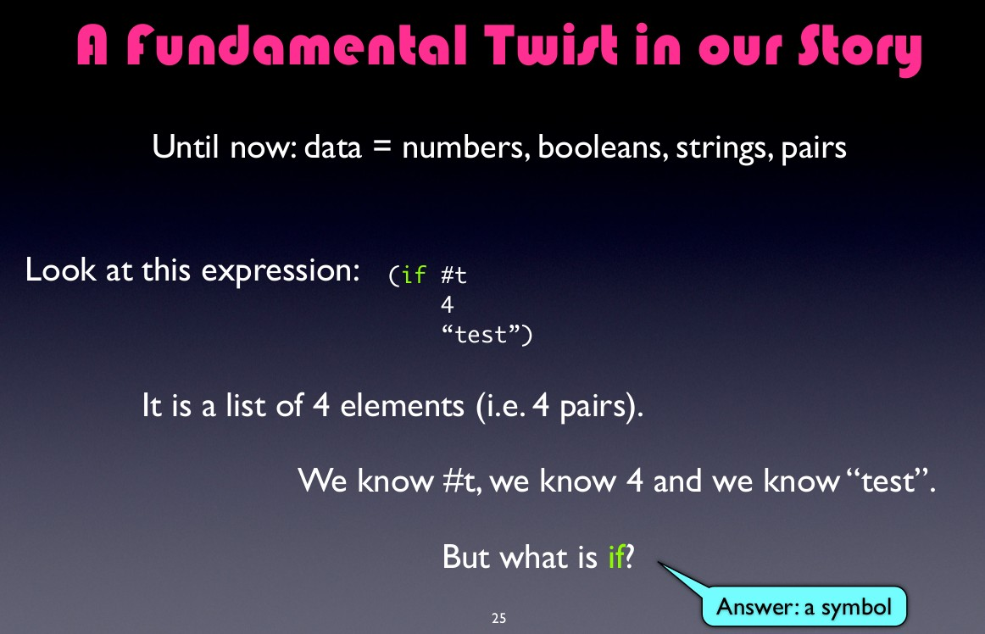

Slide 3
(1 4 9 16 25)

Slide 4
(1 | 4 | 9 | 16 | 25)
(a | b | c | d)

Slide 5
(1 | 4 | 9 | 16 | 25)
(a | b | c | d)
(* | (+ | 4 | 9) | (- | 10 | 5))

Slide 6
(1 | 4 | 9 | 16 | 25)
(a | b | c | d)
(* | (+ | 4 | 9) | (- | 10 | 5))
(define (square x) (*
x x))

Slide 8
(a b)

Slide 9
(a b)
(list a b)

Slide 10
(a b)
(list a b)
a: undefined; cannot reference an
identifier before its definition

Slide 11
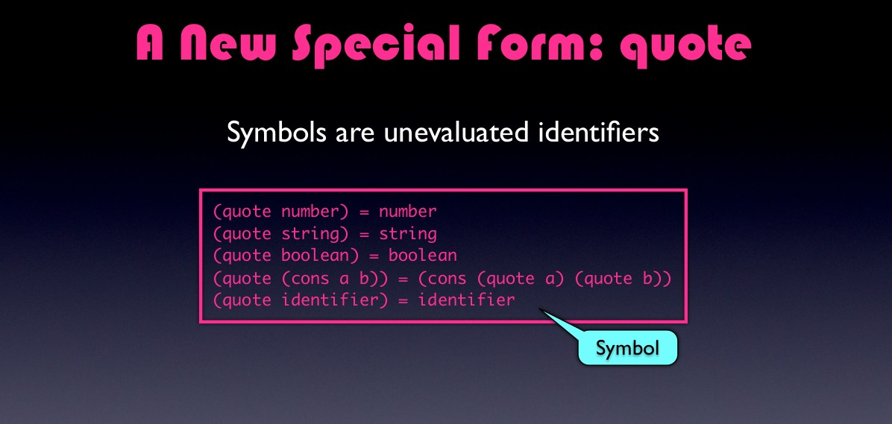

Slide 12
'(cons a b)
'(a.b)

Slide 13
(define | a | 1)
(define | b | 1)

Slide 14
(define a 1)
(define b 1) (list a b)

Slide 15
(define | a | 1)
(define | b | 1)
(list a b) → (1 2)

Slide 16
(define | a | 1)
(define | b | 1)
(list a b) → (1 2)
(list 'a 'b)

Slide 17
(define | a | 1)
(define | b | 1)
(list a b) → (1 2)
(list 'a 'b)→ (a b)

Slide 18
(define a 1)
(define b 1)
(list a b) → (1 2) (list 'a 'b)→ (a b) (list 'a b)

Slide 19
(define | a | 1)
(define | b | 1)
(list a b) → (1 2)
(list 'a 'b)→ (a b)
(list 'a b)→ (a 2)

Slide 20
memq
(memq 'apple '(banana orange grapes))
#f

Slide 21
memq
(memq 'apple '(banana orange grapes))
#f
(memq 'apple '(x (peach apple) grapes apple)) (apple pear)

Slide 22
memq
(define (memq item x)

Slide 23
memq
(define | (memq item | x)
(cond | ((null? x) | #f)

Slide 24
memq
(define | (memq item | x)
(cond | ((null? x) | #f)
 | ((eq? item | (car | x)) | x)

Slide 25
memq
(define (memq item x) (cond ((null? x) #f)
((eq? item (car x)) x)
(else (memq item (cdr x)))))

Slide 26
memq
(define (memq item x) (cond ((null? x) #f)
((eq? item (car x)) x)
(else (memq item (cdr x)))))
(memq 'apple '(banana orange grapes))

Slide 27
memq
(define (memq item x) (cond ((null? x) #f)
((eq? item (car x)) x)
(else (memq item (cdr x)))))
(memq | 'apple | '(banana | orange | grapes))
(memq | 'apple | '(banana | apple | grapes))

Slide 28
memq
(define (memq item x) (cond ((null? x) #f)
((eq? item (car x)) x)
(else (memq item (cdr x)))))
(memq | 'apple | '(banana | orange | grapes))
(memq | 'apple | '(banana | apple | grapes))
(memq | 'apple | '(banana | orange | apple))

Slide 29
memq
(define | (memq item | x)
(cond | ((null? x) | #f)
 | ((eq? item | (car | x)) | x)
(else (memq item (cdr x)))))
(memq 'apple '(y (apple sauce) apple pear))

Slide 30
memq
(define (memq item x) (cond ((null? x) #f)
((eq? item (car x)) x)
(else (memq item (cdr x)))))
(memq | 'apple | '(x | (apple | sauce) | apple | pear))
(apple | pear)

Slide 31
memq
(define (memq item x) (cond ((null? x) #f)
((eq? item (car x)) x)
(else (memq item (cdr x)))))
apple pear))
(memq | 'apple | '(x | (apple | sauce)
(apple (memq | pear) 'apple | '(x | (apple | sauce)
pear))

Slide 32
memq
(define (memq item x) (cond ((null? x) #f)
((eq? item (car x)) x)
(else (memq item (cdr x)))))
(memq | 'apple | '(x | (apple | sauce) | apple pear))
(apple | pear)
(memq #f | 'apple | '(x | (apple | sauce) | pear))

Slide 33
Rewrite the procedure
memq so that it can
handle nested lists and submit tomorrow!!

Slide 34
dc ₌₀
Symbolic Differentiation
dx
dx ₌₁
dx
_{d} (u+v )₌ du ₊ dv
dx dx dx
(uv )
dx
( ) ( )
dv dx
dv dx
d
=u
+v

Slide 35
(define | deriv exp | var)
(cond | ((number? | exp) | 0)

Slide 36
dc ₌₀
Symbolic Differentiation
dx
dx ₌₁
dx
_{d} (u+v )₌ du ₊ dv
dx dx dx
(uv )
dx
( ) ( )
dv dx
dv dx
d
=u
+v

Slide 37
(define deriv exp var) (cond ((number? exp) 0)
((variable? exp)

Slide 38
(define deriv exp var) (cond ((number? exp) 0)
((variable? exp)
(if (same-variable? exp var) 1 0))

Slide 39
dc ₌₀
Symbolic Differentiation
dx
dx ₌₁
dx
_{d} (u+v )₌ du ₊ dv
dx dx dx
(uv )
dx
( ) ( )
dv dx
dv dx
d
=u
+v

Slide 40
(define deriv exp var) (cond ((number? exp) 0)
((variable? exp)
(if (same-variable? exp var) 1 0)) ((sum? exp)

Slide 41
(define deriv exp var) (cond ((number? exp) 0)
((variable? exp)
(if (same-variable? exp var) 1 0)) ((sum? exp)
(deriv (addend exp) var)
(deriv (augend exp) var))

Slide 42
(define deriv exp var) (cond ((number? exp) 0)
((variable? exp)
(if (same-variable? exp var) 1 0)) ((sum? exp)
(make-sum (deriv (addend exp) var)
(deriv (augend exp) var)))

Slide 43
dc ₌₀
Symbolic Differentiation
dx
dx ₌₁
dx
_{d} (u+v )₌ du ₊ dv
dx dx dx
(uv )
dx
( ) ( )
dv dx
dv dx
d
=u
+v

Slide 44
(define deriv exp var) (cond ((number? exp) 0)
((variable? exp)
(if (same-variable? exp var) 1 0)) ((sum? exp)
(make-sum (deriv (addend exp) var)
(deriv (augend exp) var))) ((product? exp)

Slide 45
(define deriv exp var) (cond ((number? exp) 0)
((variable? exp)
(if (same-variable? exp var) 1 0)) ((sum? exp)
(make-sum (deriv (addend exp) var)
(deriv (augend exp) var))) ((product? exp)
(multiplier exp)
(deriv (multiplicand exp) var)
(deriv (multiplier exp) var) (multiplicand exp)

Slide 46
(define deriv exp var) (cond ((number? exp) 0)
((variable? exp)
(if (same-variable? exp var) 1 0)) ((sum? exp)
(make-sum (deriv (addend exp) var)
(deriv (augend exp) var))) ((product? exp)
(make-product (multiplier x)
(deriv (multiplicand exp) var)) (make-product
(deriv (multiplier exp) var) (multiplicand exp))))

Slide 47
(define deriv exp var) (cond ((number? exp) 0)
((variable? exp)
(if (same-variable? exp var) 1 0)) ((sum? exp)
(make-sum (deriv (addend exp) var)
(deriv (augend exp) var))) ((product? exp)
(make-sum
(make-product (multiplier x)
(deriv (multiplicand exp) var)) (make-product
(deriv (multiplier exp) var) (multiplicand exp))))

Slide 48
(define deriv exp var) (cond ((number? exp) 0)
((variable? exp)
(if (same-variable? exp var) 1 0)) ((sum? exp)
(make-sum (deriv (addend exp) var)
(deriv (augend exp) var))) ((product? exp)
(make-sum
(make-product (multiplier x)
(deriv (multiplicand exp) var)) (make-product
(deriv (multiplier exp) var) (multiplicand exp))))
(else
(error “Unknown Expression Type”))))

Slide 49
(define deriv exp var) (cond ((number? exp) 0)
((variable? exp)
(if (same-variable? exp var) 1 0)) ((sum? exp)
(make-sum (deriv (addend exp) var)
(deriv (augend exp) var))) ((product? exp)
(make-sum
(make-product (multiplier x)
(deriv (multiplicand exp) var)) (make-product
(deriv (multiplier exp) var)
(multiplicand exp)))) (else
(error “Unknown Expression Type”))))

Slide 50
ax +b
Representation
(+ (* a x) b)

Slide 51
(define deriv exp var) (cond ((number? exp) 0)
((variable? exp)
(if (same-variable? exp var) 1 0)) ((sum? exp)
(make-sum (deriv (addend exp) var)
(deriv (augend exp) var))) ((product? exp)
(make-sum
(make-product (multiplier x)
(deriv (multiplicand exp) var)) (make-product
(deriv (multiplier exp) var) (multiplicand exp))))
(else
(error “Unknown Expression Type”))))

Slide 52
variable?
(+ (* a x) b)
(define (variable? x)

Slide 53
variable?
(+ (* a x) b)
(define (variable? x) (symbol? x))

Slide 54
(define deriv exp var) (cond ((number? exp) 0)
((variable? exp)
(if (same-variable? exp var) 1 0)) ((sum? exp)
(make-sum (deriv (addend exp) var)
(deriv (augend exp) var))) ((product? exp)
(make-sum
(make-product (multiplier x)
(deriv (multiplicand exp) var)) (make-product
(deriv (multiplier exp) var) (multiplicand exp))))
(else
(error “Unknown Expression Type”))))

Slide 55
same-variable?
(+ (* a x) b)
(define (same-variable? v1 v2)

Slide 56
same-variable?
(+ (* a x) b)
(define (same-variable? v1 v2) (and (variable? v1)
(variable? v2)

Slide 57
same-variable?
(+ (* a x) b)
(define (same-variable? v1 v2) (and (variable? v1)
(variable? v2) (eq? v1 v2)))

Slide 58
(define deriv exp var) (cond ((number? exp) 0)
((variable? exp)
(if (same-variable? exp var) 1 0)) ((sum? exp)
(make-sum (deriv (addend exp) var)
(deriv (augend exp) var))) ((product? exp)
(make-sum
(make-product (multiplier x)
(deriv (multiplicand exp) var)) (make-product
(deriv (multiplier exp) var) (multiplicand exp))))
(else
(error “Unknown Expression Type”))))

Slide 59
sum?
(+ (* a x) b)
(define (sum? x)

Slide 60
sum?
(+ (* a x) b)
(define (sum? x) (and (pair? x)

Slide 61
sum?
(+ (* a x) b)
(define (sum? x) (and (pair? x)
(eq? (car x) '+)))

Slide 62
sum? product? (+ (* a x) b)
(define (sum? x) (and (pair? x)
(eq? (car x) '+)))
(define (product? x) (and (pair? x)
(eq? (car x) '*)))

Slide 63
(define deriv exp var) (cond ((number? exp) 0)
((variable? exp)
(if (same-variable? exp var) 1 0)) ((sum? exp)
(make-sum (deriv (addend exp) var)
(deriv (augend exp) var))) ((product? exp)
(make-sum
(make-product (multiplier x)
(deriv (multiplicand exp) var)) (make-product
(deriv (multiplier exp) var) (multiplicand exp))))
(else
(error “Unknown Expression Type”))))

Slide 64
make-sum
(define (make-sum a1 a2)

Slide 65
dc ₌₀
Symbolic Differentiation
dx
dx ₌₁
dx
_{d} (u+v )₌ du ₊ dv
dx dx dx
(uv )
dx
( ) ( )
dv dx
dv dx
d
=u
+v

Slide 66
 | make-sum
(define (list | (make-sum a1 '+ a1 a2)) | a2)

Slide 67
make-sum make-product
(define (list | (make-sum a1 '+ a1 a2)) | a2)
(define (list | (make-product '* m1 m2)) | m1 | m2)

Slide 68
(define deriv exp var) (cond ((number? exp) 0)
((variable? exp)
(if (same-variable? exp var) 1 0)) ((sum? exp)
(make-sum (deriv (addend exp) var)
(deriv (augend exp) var))) ((product? exp)
(make-sum
(make-product (multiplier x)
(deriv (multiplicand exp) var)) (make-product
(deriv (multiplier exp) var) (multiplicand exp))))
(else
(error “Unknown Expression Type”))))

Slide 69
addend/augend
 | (+ (* a | x) | b)
(define (define | (addend (augend | s) s)

Slide 70
addend/augend
 | (+ (* a | x) b)
(define (cadr | (addend s)) | s)
(define | (augend | s)

Slide 71
addend/augend
 | (+ (* a | x) b)
(define (cadr | (addend s)) | s)
(define | (augend | s)
(caddr s))

Slide 72
multiplier/multiplicand
(* (* a x) b)
(define (multiplier s) (cadr s))
(define (multiplicand s) (caddr s))

Slide 73
(define deriv exp var) (cond ((number? exp) 0)
((variable? exp)
(if (same-variable? exp var) 1 0)) ((sum? exp)
(make-sum (deriv (addend exp) var)
(deriv (augend exp) var))) ((product? exp)
(make-sum
(make-product (multiplier x)
(deriv (multiplicand exp) var)) (make-product
(deriv (multiplier exp) var) (multiplicand exp))))
(else
(error “Unknown Expression Type”))))

Slide 74
Applying deriv
(deriv '(+ x 3) 'x) →

Slide 75
Applying deriv
(deriv '(+ x 3) 'x) →
(+ 1 0)

Slide 76
Applying deriv
(deriv | '(+ | x | 3) | 'x) | → | (+ | 1 | 0)
(deriv | '(* | x | y) | 'x) | →

Slide 77
(define deriv exp var) (cond ((number? exp) 0)
((variable? exp)
(if (same-variable? exp var) 1 0)) ((sum? exp)
(make-sum (deriv (addend exp) var)
(deriv (augend exp) var))) ((product? exp)
(make-sum
(make-product (multiplier x)
(deriv (multiplicand exp) var)) (make-product
(deriv (multiplier exp) var) (multiplicand exp))))
(else
(error “Unknown Expression Type”))))

Slide 78
Applying deriv
(deriv | '(+ | x | 3) | 'x) | → | (+ | 1 0)
(deriv | '(* | x | y) | 'x) | →
(+ (* x 0) (* 1 y))

Slide 79
Applying deriv
(deriv (deriv | '(+ '(* | x 3) 'x) → x y) 'x) → (+ (* x 0) | (+ 1 (* 1 | 0) y))
(deriv | '(* | (* x y) (+ | x 3)) | 'x)
→

Slide 80
(define deriv exp var) (cond ((number? exp) 0)
((variable? exp)
(if (same-variable? exp var) 1 0)) ((sum? exp)
(make-sum (deriv (addend exp) var)
(deriv (augend exp) var))) ((product? exp)
(make-sum
(make-product (multiplier x)
(deriv (multiplicand exp) var)) (make-product
(deriv (multiplier exp) var) (multiplicand exp))))
(else
(error “Unknown Expression Type”))))

Slide 81
Applying deriv
(deriv (deriv | '(+ '(* | x x | 3) y) | 'x) 'x) | → → | (+ | 1 | 0)
(deriv '(* |  | (+ (* x 0) (* 1 (* x y) (+ x 3)) |  |  |  |  |  | y)) 'x)
→ (+ (* (* (* (+ (+ |  | x y)(+ 1 0)) (* x 0) (* 1 y)) x 3)))
(+ (* x y) (* y (+ x 3)))

Slide 82
make-product
(define (make-prod m1 m2) (cond((or (=number? m1 0)
(=number? m2 0)) 0) ((=number? m1 1) m2) ((=number? m2 1) m1) ((and (number? m1)
(number? m2)) (* m1 m2))
(else (list '* a1 a2))))

Slide 83
make-sum
(define (make-sum | a1 | a2)
(cond((=number? | a1 | 0) | a2)
((=number? | a2 | 0) | a1)
((and (number? a1)
(number? a2)) (+ a1 a2))
(else (list '+ a1 a2))))
(define (=number? exp num)
(and (number? exp) (= exp num)))

Slide 84
Representing Sets
Element-of-set?
●
Adjoin-set
●
Intersection-set
●
Union-set
●

Slide 85
element-of-set?
(Sets as Unordered Lists)
(define (element-of-set? x set)

Slide 86
element-of-set?
(Sets as Unordered Lists)
(define (element-of-set? x set) (cond ((null? set) false)

Slide 87
element-of-set?
(Sets as Unordered Lists)
(define (element-of-set? x set) (cond ((null? set) false)
((equal? x (car set)) true)

Slide 88
element-of-set?
(Sets as Unordered Lists)
(define (element-of-set? x set) (cond ((null? set) false)
((equal? x (car set)) true) (else (element-of-set? x
(cdr set)))))

Slide 89
element-of-set?
(Sets as Ordered Lists)
(define (element-of-set? x set) (cond ((null? set) false)

Slide 90
element-of-set?
(Sets as Ordered Lists)
(define (element-of-set? x set) (cond ((null? set) false)
((= x (car set)) true)

Slide 91
element-of-set?
(Sets as Ordered Lists)
(define (element-of-set? x set) (cond ((null? set) false)
((= x (car set)) true) (else (element-of-set? x
(cdr set)))))

Slide 92
element-of-set?
(Sets as Ordered Lists)
(define (element-of-set? x set) (cond ((null? set) false)
((= x (car set)) true) (else (element-of-set? x
(cdr set)))))
What if x is < first element of set?

Slide 93
element-of-set?
(Sets as Ordered Lists)
(define (element-of-set? x set) (cond ((null? set) false)
((= x (car set)) true) ( ?? )
(else (element-of-set? x
(cdr set)))))

Slide 94
element-of-set?
(Sets as Ordered Lists)
(define (element-of-set? x set) (cond ((null? set) false)
((= x (car set)) true)
((< x (car set)) false) (else (element-of-set? x
(cdr set)))))

Slide 95
element-of-set?
(Sets as Ordered Lists)
(define (element-of-set? x set) (cond ((null? set) false)
((= x (car set)) true)
((< x (car set)) false) (else (element-of-set? x
(cdr set)))))

Slide 96
adjoin-set
(Sets as unordered lists)
(define (adjoin-set x set) (if (element-of-set? x set)
set
(cons x set)))

Slide 97
adjoin-set
(Sets as unordered lists)
(define (adjoin-set x set) (if (element-of-set? x set)
set
(cons x set)))

Slide 98
intersection-set
(sets as unordered lists)
(define (intersection-set set1 set2)

Slide 99
intersection-set
(sets as unordered lists)
(define | (intersection-set | set1 set2)
(cond | ((or (null? set1) | (null? set2)) | '())

Slide 100
intersection-set
(sets as unordered lists)
(define (intersection-set set1 set2)
(cond ((or (null? set1) (null? set2)) '()) ((element-of-set? (car set1) set2)
(cons (car set1)
(intersection-set (cdr set1) set2)))

Slide 101
intersection-set
(sets as unordered lists)
(define (intersection-set set1 set2)
(cond ((or (null? set1) (null? set2)) '()) ((element-of-set? (car set1) set2)
(cons (car set1)
(intersection-set (cdr set1) set2))) (else (intersection-set (cdr set1) set2))))
SET1: {1, 4, 3 , 8}
SET2: {10, 4, 1}

Slide 102
intersection-set
(sets as ordered lists)
(define (intersection-set set1 set2)

Slide 103
intersection-set
(sets as ordered lists)
(define (intersection-set set1 set2) (if (or (null? set1) (null? set2))
'())

Slide 104
intersection-set
(sets as ordered lists)
(define (intersection-set set1 set2) (if (or (null? set1) (null? set2))
'())
(let ((x1 (car set1)) (x2 (car set2)))

Slide 105
intersection-set
(sets as ordered lists)
(define (intersection-set set1 set2) (if (or (null? set1) (null? set2))
'())
(let ((x1 (car set1)) (x2 (car set2))) (cond ((= x1 x2)
(cons x1
(intersection-set (cdr set1)
(cdr set2))))

Slide 106
intersection-set
(sets as ordered lists)
(define (intersection-set set1 set2) (if (or (null? set1) (null? set2))
'())
(let ((x1 (car set1)) (x2 (car set2))) (cond ((= x1 x2)
(cons x1
(intersection-set (cdr set1)
(cdr set2))))
((< x1 x2)
(intersection-set (cdr set1) set2))

Slide 107
intersection-set
(sets as ordered lists)
(define (intersection-set set1 set2) (if (or (null? set1) (null? set2))
'())
(let ((x1 (car set1)) (x2 (car set2))) (cond ((= x1 x2)
(cons x1
(intersection-set (cdr set1)
(cdr set2))))
((< x1 x2)
(intersection-set (cdr set1) set2)) ((> x1 x2)
(intersection-set set1 (cdr set2)))))))
SET1: {2, 4, 6, 8}
SET2: {3, 4, 5, 6}

Slide 108
Ordered sets as Binary Trees
Ordered sets can be represented as Binary Trees.
One ordered set can have multiple representations.
Each node contains 3 elements:
Entry node
Left sub-tree
Right sub-tree
Empty left-subtree and right-subtree is represented as empty list.
Rule: Elements in left sub-tree always lesser than entry node
Elements in right sub-tree always greater than entry node.

Slide 109





Representing Sets
(Sets as Binary Trees)
3
2
7
5
9
Binary tree representation for {2, 3, 5, 7, 9, 11}
11

Slide 110


Representing Sets
(Sets as Binary Trees)
5
3
9
7
11
2
Binary tree representation for {2, 3, 5, 7, 9, 11}

Slide 111



Representing Sets
(Sets as Binary Trees)
7
3
9
11
2
5
Binary tree representation for {2, 3, 5, 7, 9, 11}

Slide 112
Representing Sets
(Sets as Binary Trees)
(define (make-tree? entry left right)

Slide 113
Representing Sets
(Sets as Binary Trees)
(define (make-tree? entry left right) (list entry left right))

Slide 114
Representing Sets as Binary Trees)
3
2
7
5
9
Binary tree representation for {2, 3, 5, 7, 9, 11}
(define tree2 '(3 (2 () ()) (7 (5 () ()) (9 () (11 () ())))))
11

Slide 115
Representing Sets as Binary Trees)
5
3
9
7
11
2
Binary tree representation for {2, 3, 5, 7, 9, 11}
'(5 (3 (2 () ()) ()) (9 (7 () ()) (11 () ())))

Slide 116
Representing Sets
(Sets as Binary Trees)
(define (make-tree? entry left right) (list entry left right))
(define (entry tree)

Slide 117
Representing Sets
(Sets as Binary Trees)
(define (make-tree? left right)
(list entry left right))
(define (entry tree)
(car tree))

Slide 118
Representing Sets as Binary Trees)
3
2
7
5
9
(define tree2 '(3 (2 () ()) (7 (5 () ()) (9 () (11 () ())))))
(entry tree2)
=> (car tree2)
=> 3
11

Slide 119
Representing Sets
(Sets as Binary Trees)
(define (make-tree? left right)
(list entry left right))
(define (entry tree)
(car tree))
(define (left-branch tree)

Slide 120
Representing Sets as Binary Trees)
3
2
7
5
9
(define tree2 '(3 (2 () ()) (7 (5 () ()) (9 () (11 () ())))))
(left-branch tree2) i.e. Fetching (2 () ())
(cdr tree2) => ((2 () ()) (7 (5 () ()) (9 () (11 () ()))))
(car (cdr tree2)) => (2 () ())
11

Slide 121
Representing Sets
(Sets as Binary Trees)
(define (make-tree? left right)
(list entry left right))
(define (entry tree) (car tree))
(define (left-branch tree)(cadr tree))

Slide 122
Representing Sets
(Sets as Binary Trees)
(define (make-tree? left right)
(list entry left right))
(define (entry tree) (car tree)) (define (left-branch tree) (cadr tree)) (define (right-branch tree)

Slide 123
Representing Sets as Binary Trees)
3
2
7
5
9
(define tree2 '(3 (2 () ()) (7 (5 () ()) (9 () (11 () ())))))
(right-branch tree2) = Fetch (7 (5 () ()) (9 () (11 () ())))
(cdr tree2)=> ((2 () ()) (7 (5 () ()) (9 () (11 () ()))))
(cdr (cdr tree2)) => ((7 (5 () ()) (9 () (11 () ()))))
(car (cdr (cdr tree2))) => (7 (5 () ()) (9 () (11 () ())))
11

Slide 124
Representing Sets
(Sets as Binary Trees)
(define (make-tree? left right)
(list entry left right))
(define (entry tree) (car tree)) (define (left-branch tree) (cadr tree))
(define (right-branch tree) (caddr tree))

Slide 125
Representing Sets as Binary Trees)
3
2
7
5
9
(define tree2 '(3 (2 () ()) (7 (5 () ()) (9 () (11 () ())))))
(entry tree2) => (car tree2) == 3
(left-branch tree2)
=> (cadr tree2) == (2 () ())
(right-branch tree2)
=> (caddr tree2) == (7 (5 () ()) (9 () (11 () ())))
11

Slide 126
element-of-set?
(Sets as Binary Trees)
(define (element-of-set? x set)

Slide 127
element-of-set?
(Sets as Binary Trees)
(define (element-of-set? x set) (cond ((null? set) false)

Slide 128
element-of-set?
(Sets as Binary Trees)
(define (element-of-set? x set) (cond ((null? set) false)
((= x (entry set)) true)

Slide 129
element-of-set?
(Sets as Binary Trees)
(define (element-of-set? x set) (cond ((null? set) false)
((= x (entry set)) true) ((< x (entry set))

Slide 130
element-of-set?
(Sets as Binary Trees)
(define (element-of-set? x set) (cond ((null? set) false)
((= x (entry set)) true) ((< x (entry set))
(element-of-set? x (left-branch set)))

Slide 131
element-of-set?
(Sets as Binary Trees)
(define (element-of-set? x set) (cond ((null? set) false)
((= x (entry set)) true) ((< x (entry set))
(element-of-set? x (left-branch set))) ((> x (entry set))

Slide 132
element-of-set?
(Sets as Binary Trees)
(define (element-of-set? x set) (cond ((null? set) false)
((= x (entry set)) true) ((< x (entry set))
(element-of-set? x (left-branch set))) ((> x (entry set))
(element-of-set? x (right-branch set)))))

Slide 133
adjoin-set
(define (adjoin-set x set)

Slide 134
adjoin-set
(define | (adjoin-set | x | set)
(cons | x set))

Slide 135
Representing Sets as Binary Trees)
3
2
7
Insert ‘1’ into this tree at appropriate location
5
9
(define tree2 '(3 (2 () ()) (7 (5 () ()) (9 () (11 () ())))))
(entry tree2) => (car tree2) == 3
(left-branch tree2)
=> (cadr tree2) == (2 () ())
(right-branch tree2)
=> (caddr tree2) == (7 (5 () ()) (9 () (11 () ())))
11

Slide 136
adjoin-set
(sets as binary trees)
(define (adjoin-set x set)
(cond ((null? set) (make-tree x '() '())) ((= x (entry set)) set)
((< x (entry set)) (make-tree (entry set)
(adjoin-set x (left-branch set)) (right-branch set)))
((> x (entry set)) (make-tree (entry set)
(left-branch set)
(adjoin-set x (right-branch set))
))))

Slide 137
adjoin-set (step by step)
(define tree2 '(3 (2 () ()) (7 (5 () ()) (9 () (11 () ())))))
(adjoin-set 1 tree2)
(make-tree 3 (adjoin-set 1 (2 () ())) (7 (5 () ()) (9 () (11 () ()))))
(make-tree 3 (make-tree 2 (adset 1 ()) ()) (7 (5 () ()) (9 () (11 () ()))))
(make-tree 3 (make-tree 2 (make-tree 1 ‘() ‘()) ()) (7 (5 () ()) (9 () (11 () ()))))
(make-tree 3 (make-tree 2 (1 () ()) ()) (7 (5 () ()) (9 () (11 () ()))))
(make-tree 3 (2 (1 () ()) ()) (7 (5 () ()) (9 () (11 () ()))))
(3 (2 (1 () ()) ()) (7 (5 () ()) (9 () (11 () ()))))

Slide 138
Representing Sets as Binary Trees)
Insert ‘1’ into this tree at appropriate location
3
2
7
1
9
5
(define tree2 '(3 (2 () ()) (7 (5 () ()) (9 () (11 () ())))))
(entry tree2) => (car tree2) == 3
(left-branch tree2)
=> (cadr tree2) == (2 () ())
(right-branch tree2)
=> (caddr tree2) == (7 (5 () ()) (9 () (11 () ())))
11

Slide 139
element-of-set?
(Sets as Unordered Lists)
(define (element-of-set? x set) (cond ((null? set) false)
((equal? x (car set)) true) (else (element-of-set? x
(cdr set)))))

Slide 140
look-up
(in the context of info retrieval)
(define (look-up given-key set-of-records) (cond ((null? set-of-records) false)
((equal? given-key
(key (car set-of-records))) (car set-of-records))
(else (look-up given-key
(cdr set-of-records)))))
Here, key is a user-define procedure to generate key for a document

Slide 141
Representing Data
A - 000
B - 001
C - 010
D - 011
E - 100
F - 101
G - 110
H - 111
A - 0
B - 100
C - 1010
D - 1011
E - 1100
F - 1101
G - 1110
H - 1111
●
●
●
●
●
●
●
●
●
●
●
●
●
●
●
●

Slide 142














Huffman Encoding Tree
{A B C D E F G H} 17
{B C D E F G H} 9
A 8
{B C D} 5
{E F G H} 4
{C D} 2
B 3
{G H} 2
{E F} 2
C 1
D 1
G 1
H 1
E 1
F 1

Slide 143
Representing Huffman Trees
(define (make-leaf symbol weight) (list 'leaf symbol weight))

Slide 144
Representing Huffman Trees
(define (make-leaf symbol weight) (list 'leaf symbol weight))
(make-leaf 'A 4)→ ('leaf 'A 4)

Slide 145
Representing Huffman Trees
(define (make-leaf symbol weight) (list 'leaf symbol weight))
(define (leaf? object)
(eq? (car object) 'leaf))

Slide 146
Representing Huffman Trees
(define (make-leaf symbol weight) (list 'leaf symbol weight))
(define (leaf? object)
(eq? (car object) 'leaf))
(define (symbol-leaf x) (cadr x))

Slide 147
Representing Huffman Trees
(define (make-leaf symbol weight) (list 'leaf symbol weight))
(define (leaf? object)
(eq? (car object) 'leaf))
(define (symbol-leaf x) (cadr x)) (define (weight-leaf x) (caddr x))

Slide 148





Representing Huffman Trees
(define (make-code-tree left right)
??
)
A 4
B 2
C 1
D 1

Slide 149






Representing Huffman Trees
A 4
B 2
(define tree
C 1
D 1
(make-code-tree (make-leaf 'A 4)

Slide 150
Representing Huffman Trees
A 4
B 2
(define tree
C 1
D 1
(make-code-tree (make-leaf 'A 4) (make-code-tree (make-leaf 'B 2)

Slide 151
Representing Huffman Trees
A 4
B 2
(define tree
C 1
D 1
(make-code-tree (make-leaf 'A 4) (make-code-tree (make-leaf 'B 2)
(make-code-tree (make-leaf 'C 1)

Slide 152
Representing Huffman Trees
A 4
B 2
(define tree
C 1
D 1
(make-code-tree (make-leaf 'A 4) (make-code-tree (make-leaf 'B 2)
(make-code-tree (make-leaf 'C 1)
(make-leaf 'D 1)
))))

Slide 153
Representing Huffman Trees
(define (make-code-tree left right) (list left
right
(append |  | (symbols (symbols |  | left) right))
(+ | (weight (weight |  | left) right))))

Slide 154
Representing Huffman Trees
(define (symbols tree)
(if (leaf? tree)
(list (symbol-leaf tree))
(caddr tree)))

Slide 155
Representing Huffman Trees
(define (symbols tree)
(if (leaf? tree)
(list (symbol-leaf tree))
(caddr tree)))
(define (weight tree)
(if (leaf? tree)
(weight-leaf tree)) (cadddr tree)))

Slide 156
Representing Huffman Trees
(define (left-branch tree) (car tree))
(define (right-branch tree) (cdr tree))

Slide 157
Representing Huffman Trees
(define (make-code-tree left right) (list left
right
(append |  | (symbols (symbols |  | left) right))
(+ | (weight (weight |  | left) right))))

Slide 158
Representing Huffman Trees
A 4
B 2
(define tree
C 1
D 1
(make-code-tree (make-leaf 'A 4) (make-code-tree (make-leaf 'B 2)
(make-code-tree (make-leaf 'C 1)
(make-leaf 'D 1)
))))

Slide 159
Representing Huffman Trees
(('leaf | 'D | 1) | ('leaf | 'C | 1)
(D C) | 2)

Slide 160
Representing Huffman Trees
A 4
B 2
(define tree
C 1
D 1
(make-code-tree (make-leaf 'A 4) (make-code-tree (make-leaf 'B 2)
(make-code-tree (make-leaf 'D 1)
(make-leaf 'C 1)
))))

Slide 161
Representing Huffman Trees
(('leaf | 'B | 2) | (
(('leaf | 'D | 1) | ('leaf | 'C | 1)
(D C) | 2)
(B (DC)) 4)

Slide 162
Representing Huffman Trees
A 4
B 2
(define tree
C 1
D 1
(make-code-tree (make-leaf 'A 4) (make-code-tree (make-leaf 'B 2)
(make-code-tree (make-leaf 'D 1)
(make-leaf 'C 1)
))))

Slide 163
Representing Huffman Trees
(('leaf 'A 4)
(('leaf 'B 2)
(('leaf 'D 1) ('leaf 'C 1)
(D C) 2) (B (D C)) 4)
(A (B (D C))) 8)

Slide 164
Decoding Huffman Trees
(define (decode bits tree)
(define (decode-1 bits current-branch) (if (null? bits)
'()
(let ((next-branch
(choose-branch (car bits) current-branch))) (if (leaf? next-branch)
(cons (symbol-leaf next-branch) (decode-1 (cdr bits) tree))
(decode-1 (cdr bits) next-branch))))) (decode-1 bits tree))
(define (choose-branch bit branch) (cond ((= bit 0) (left-branch branch))
((= bit 1) (right-branch branch)) (else (error “bad bit” bit))))

Slide 165
Representing Huffman Trees
(('leaf 'A 4)
(('leaf 'B 2)
((('leaf 'D 1) ('leaf 'C 1) '(D C)2)
'(B | (D | C)) | 4)
'(A | (B | (D | C))) | 8)
(define bits '(0 1 0))

Slide 166
look-up
(in the context of info retrieval)
(define (look-up given-key set-of-records) (cond ((null? set-of-records) false)
((equal? given-key
(key (car set-of-records))) (car set-of-records))
(else (look-up given-key
(cdr set-of-records)))))
Here, key is a user-define procedure to generate key
for a document

Slide 167
Complex Numbers
Complex numbers can have multiple representations
1. Rectangular form (real and imaginary part)
2. Polar representation (magnitude and angle)
Selectors: real-part imag-part magnitude Angle
Constructors:
make-from-real-imag make-from-mag-ang
(make-from-real-imag (real-part z) (imag-part z)) (make-from-mag-ang (magnitue z) (angle z))

Slide 168
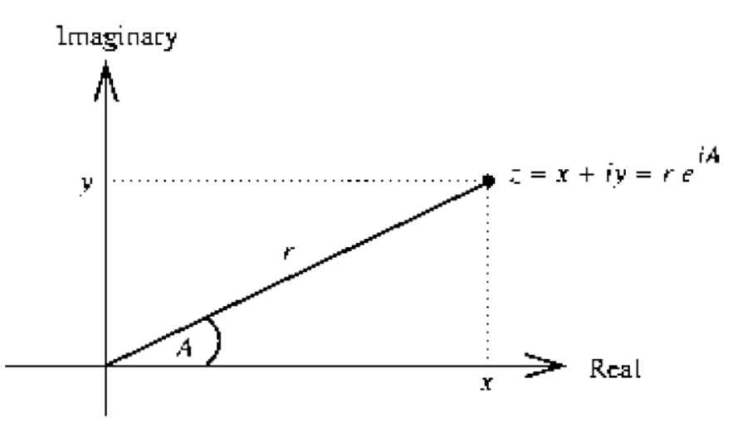
Complex Numbers: Representation
(make-from-real-imag (real-part z) (imag-part z)) (make-from-mag-ang (magnitue z) (angle z))

Slide 169
Complex Numbers: Operations
Addition and subtraction of Complex Numbers can be easily
done when represented in rectangular form.
Multiplication and Division of Complex Numbers can be easily done when represented in polar form.
Hence, Conversion of one representation to another will be required.
Lets have a look at different representations and procedures required.
And the problems occurring with Abstraction Barriers,

Slide 170
Complex Numbers: Operations
(define (add-complex (make-from-real-imag | z1 (+ | z2) (real-part | z1) | (real-part | z2))
 | (+ | (imag-part | z1) | (imag-part | z2))))

Slide 171
Complex Numbers: Operations
(define (add-complex (make-from-real-imag | z1 (+ | z2) (real-part | z1) | (real-part | z2))
 | (+ | (imag-part | z1) | (imag-part | z2))))
(define (sub-complex (make-from-real-imag | z1 (- | z2) (real-part | z1) | (real-part | z2))
 | (- | (imag-part | z1) | (imag-part | z2))))

Slide 172
Complex Numbers: Operations
(define (add-complex (make-from-real-imag | z1 (+ (+ | z2) (real-part (imag-part | z1) z1) | (real-part (imag-part | z2)) z2))))
(define (sub-complex (make-from-real-imag | z1 (- | z2) (real-part | z1) | (real-part | z2))
 | (- | (imag-part | z1) | (imag-part | z2))))
(define (mul-complex | z1 | z2)
(make-from-mag-ang (* (magnitude z1) (magnitude z2))
(+ (angle z1) (angle z2))))

Slide 173
Complex Numbers: Operations
(define (add-complex (make-from-real-imag | z1 (+ | z2) (real-part | z1) | (real-part | z2))
 | (+ | (imag-part | z1) | (imag-part | z2))))
(define (sub-complex (make-from-real-imag | z1 (- | z2) (real-part | z1) | (real-part | z2))
 | (- | (imag-part | z1) | (imag-part | z2))))
(define (mul-complex | z1 | z2)
(make-from-mag-ang (* (magnitude z1) (magnitude z2))
(+ (angle z1) (angle z2))))
(define (div-complex z1 z2) (make-from-mag-ang (/ (magnitude | z1) (magnitude | z2))
(- (angle z1) | (angle z2))))

Slide 174
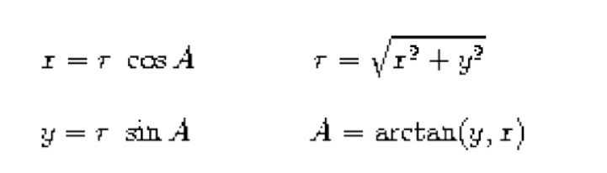
Selectors and Constructors
Conversion of complex numbers from one representation to another
Ben’s idea views complex numbers as real axis and imaginary axis

Slide 175
Selectors and Constructors
Ben’s idea views complex numbers as real axis and imaginary axis
(define | (real-part | z) | (car | z))
(define | (imag-part | z) | (cdr | z))

Slide 176
Selectors and Constructors
(define | (real-part | z) | (car | z))
(define | (imag-part | z) | (cdr | z))
(define | (magnitude | z)
(sqrt (define | (+ (square (square (angle z) | (real-part z) (imag-part z)))))
(atan | (imag-part | z) (real-part z)))

Slide 177
Selectors and Constructors
(define | (real-part | z) | (car | z))
(define | (imag-part | z) | (cdr | z))
(define | (magnitude | z)
(sqrt (define | (+ (square (square (angle z) | (real-part z) (imag-part z)))))
(atan | (imag-part | z) (real-part z)))
(define (make-from-real-imag x y) (cons x y))
(define (make-from-mag-ang r a)
(cons (* r (cos a)) (* r (sin a))))

Slide 178
Selectors and Constructors
Alyssa’s idea views complex numbers in polar form
But generic procedures must be written irrespective
of the representation of the numbers
(Data abstraction)

Slide 179
Selectors and Constructors
(define (real-part | z)
(* (magnitude z) | (cos | (angle | z))))
(define (imag-part | z)
(* (magnitude z) | (sin | (angle | z))))

Slide 180
Selectors and Constructors
(define (real-part | z)
(* (magnitude z) | (cos | (angle | z))))
(define (imag-part | z)
(* (magnitude z) | (sin | (angle | z))))
(define (magnitude z) (car z)) (define (angle z) (cdr z))

Slide 181
Selectors and Constructors
(define (real-part | z)
(* (magnitude z) | (cos | (angle | z))))
(define (imag-part | z)
(* (magnitude z) | (sin | (angle | z))))
(define (magnitude z) (car z)) (define (angle z) (cdr z))
(define (make-from-real-imag x y)
(cons (sqrt (+ (square x) (square y))) (atan y x)))
(define (make-from-mag-ang r a) (cons r a))

Slide 182
Selectors and Constructors
(define | (real-part | z) | (car | z))
(define | (imag-part | z) | (cdr | z))
(define | (magnitude | z)
(sqrt (define | (+ (square (square (angle z) | (real-part z) (imag-part z)))))
(atan | (imag-part | z) (real-part z)))
(define (make-from-real-imag x y) (cons x y))
(define (make-from-mag-ang r a)
(cons (* r (cos a)) (* r (sin a))))

Slide 183
Tagged Data
Independently, both Ben’s idea and Alyssa’s idea work perfectly fine.
But, Alyssa’s and Ben’s views cannot co exist in a system together.
Solution:
Tagging the data.

Slide 184
Tagged Data
(define (attach-tag type-tag contents) (cons type-tag contents)
(define (type-tag datum) (if (pair? datum)
(car datum)
(error “Bad tagged datum”)))
(define (contents datum) (if (pair? datum)
(cdr datum)
(error “Bad tagged datum”)))

Slide 185
Tagged Data Predicates
Checking the type of information provided
(define (rectangular? z)
(eq? (type-tag z) 'rectangular))
(define (polar? z)
(eq? (type-tag z) 'polar))

Slide 186
Selectors and Constructors
Ben’s representation
(define | (real-part | z) | (car | z))
(define | (imag-part | z) | (cdr | z))
(define | (magnitude | z)
(sqrt (define | (+ (square (square (angle z) | (real-part z) (imag-part z)))))
(atan | (imag-part | z) (real-part z)))
(define (make-from-real-imag x y) (cons x y))
(define (make-from-mag-ang r a)
(cons (* r (cos a)) (* r (sin a))))

Slide 187
New Selectors and Constructors
(define (real-part-rectangular z) (car z)) (define (imag-part-rectangular z) (cdr z))
(define (magnitude-rectangular z)
(sqrt (+ (square (real-part-rectangular z) (square (imag-part-rectangular z)))))
(define (angle-rectangular z) (atan (imag-part-rectangular z)
(real-part-rectangular z)))
(define (make-from-real-imag-rectangular x y) (attach-tag 'rectangular (cons x y)))
(define (make-from-mag-ang-rectangular r a) (attach-tag 'rectangular (cons (* r (cos a))

Slide 188
Selectors and Constructors
Alyssa’s representation
(define (real-part | z)
(* (magnitude z) | (cos | (angle | z))))
(define (imag-part | z)
(* (magnitude z) | (sin | (angle | z))))
(define (magnitude z) (car z)) (define (angle z) (cdr z))
(define (make-from-real-imag x y)
(cons (sqrt (+ (square x) (square y))) (atan y x)))
(define (make-from-mag-ang r a) (cons r a))

Slide 189
New Selectors and Constructors
(define (real-part-polar | z)
(* (magnitude-polar z) | (cos | (angle-polar | z))))
(define (imag-part-polar | z)
(* (magnitude-polar z) | (sin | (angle-polar | z))))
(define (magnitude-polar z) (car z)) (define (angle-polar z) (cdr z))
(define (make-from-real-imag-polar x y) (attach-tag 'polar (cons (sqrt (+ (square x)
(square y)))(atan y x)))) (define (make-from-mag-ang r a)
(attach-tag 'polar (cons r a)))

Slide 190
Generic Selectors
(define (real-part z) (cond ((rectangular? z)
(real-part-rectangular (contents z))) ((polar? z)
(real-part-polar (contents z))) (else (error “Unknown type”))))

Slide 191
Generic Selectors
(define (real-part z) (cond ((rectangular? z)
(real-part-rectangular (contents z))) ((polar? z)
(real-part-polar (contents z))) (else (error “Unknown type”))))
(define | (imag-part z)
(cond | ((rectangular? z)
 | (imag-part-rectangular (contents | z)))
 | ((polar? z)
 | (imag-part-polar (contents z)))
 | (else (error “Unknown type”))))

Slide 192
Generic Selectors
(define (magnitude z) (cond ((rectangular? z)
(magnitude-rectangular (contents z))) ((polar? z)
(magnitude-polar (contents z))) (else (error “Unknown type”))))
(define (angle z)
(cond ((rectangular? z)
(angle-rectangular (contents z))) ((polar? z)
(angle-polar (contents z)))
(else (error “Unknown type”))))

Slide 193
Complex Numbers: Operations
(define (add-complex (make-from-real-imag | z1 (+ | z2) (real-part | z1) | (real-part | z2))
 | (+ | (imag-part | z1) | (imag-part | z2))))
(define (sub-complex (make-from-real-imag | z1 (- | z2) (real-part | z1) | (real-part | z2))
 | (- | (imag-part | z1) | (imag-part | z2))))
(define (mul-complex | z1 | z2)
(make-from-mag-ang (* (magnitude z1) (magnitude z2))
(+ (angle z1) (angle z2))))
(define (div-complex z1 z2) (make-from-mag-ang (/ (magnitude | z1) (magnitude | z2))
(- (angle z1) | (angle z2))))

Slide 194
Constructors
(define (make-from-real-imag x y)
(make-from-real-imag-rectangular x y))
(define (make-from-mag-ang z) (make-from-mag-ang-polar r a))

